Slide 1
Paper Review-”A Transfer Learning Approach to Breast Cancer Classification in a Federated Learning Framework”
Tasnim Fuyara Chhoan(ID: 23366035)
CSE707 DIstributed Computing System
Mehnaz Ara Faizul (ST)
Humaion Kabir Mehedi (RA)
Submitted to : Annajiat Alim Rasel
Group 41

Slide 2
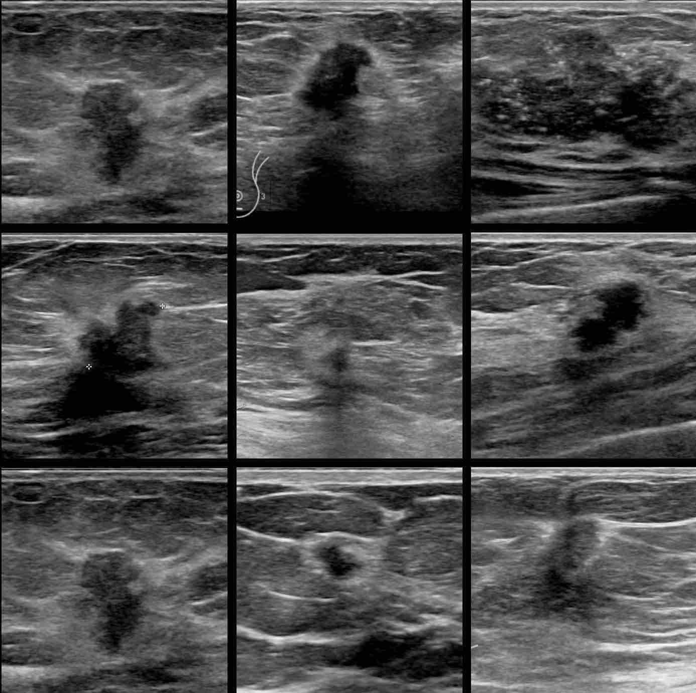
Table of Content
Summary
Motivation
Contribution
Methodology
Conclusion
Limitations
First Limitation
Second Limitation
Synthesis

Slide 3
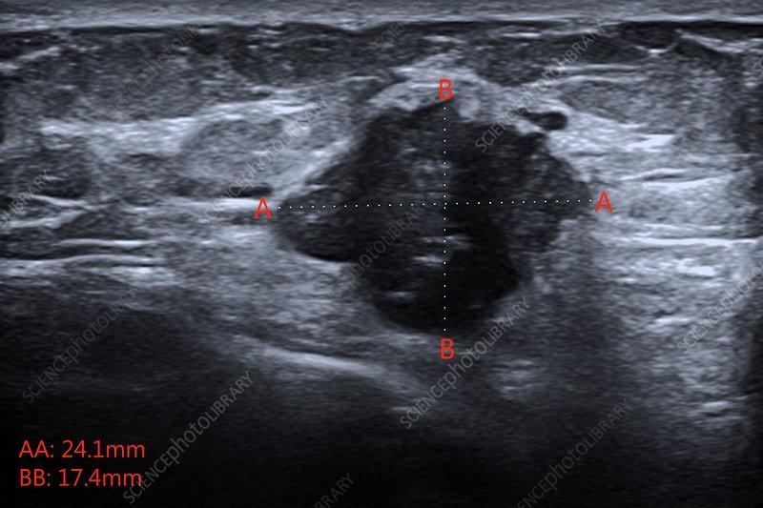
Summary
Motivation
Challenges in breast cancer classification in medical imaging.
Emphasis on dynamic nature of DDSM dataset and importance of accurate evaluations.
Goal to enhance diagnostic processes, especially in imbalanced data scenarios.

Slide 4
Summary
Contribution
Introduction of Transfer Learning using pre-trained models (MobileNet, DenseNet121, Xception, ResNet50).
Leveraging SMOTE for handling imbalanced datasets.
Efficient data splitting through scikit-learn.
Practical application of Federated Learning in medical image classification.
Balance between accuracy and preserving data privacy.

Slide 5
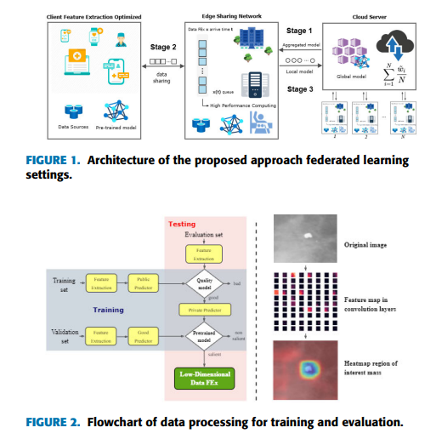
Summary
Methodology
Transfer Learning approach with pre-trained models.
FL framework with Python 3.8, TensorFlow 2.9, NVIDIA TESLA P100 GPU.
Three edge servers, four clients, and 60 communication rounds.
Data splitting using scikit-learn, FedAvg algorithm implementation.
Model assessment with K-fold cross-validation, focusing on accuracy, precision, recall, F1-score, and AUC.

Slide 6
Summary
Methodology
Transfer Learning approach with pre-trained models.
FL framework with Python 3.8, TensorFlow 2.9, NVIDIA TESLA P100 GPU.
Three edge servers, four clients, and 60 communication rounds.
Data splitting using scikit-learn, FedAvg algorithm implementation.
Model assessment with K-fold cross-validation, focusing on accuracy, precision, recall, F1-score, and AUC.

Slide 7
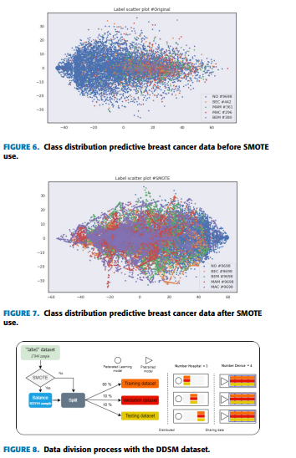
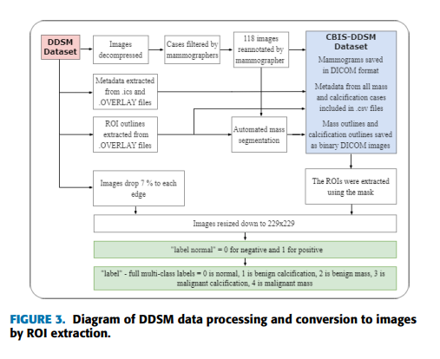
Summary
Methodology

Slide 8
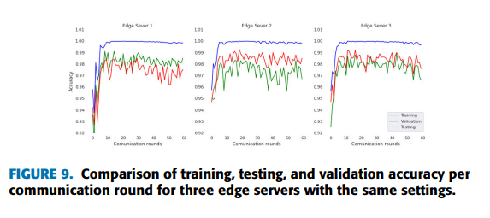
Summary
Conclusion
Key findings emphasizing comparable accuracy to centralized learning.
Preservation of data privacy across multiple participating units.

Slide 9
Limitations
First Limitation
Second Limitation
Prolonged training times associated with federated learning.
Transparent discussion of challenges adds credibility.
Performance decline in real-world scenarios, especially with an increasing number of participants.
Candid admission provides insights into practical constraints.

Slide 10
Synthesis
Pioneering exploration of federated learning and MobileNet for breast cancer classification.
Potential to transform collaborative learning in healthcare.
Findings indicate improved diagnostics and personalized patient care.
Extended training times pose a challenge, requiring careful consideration.
Broader applications in collaborative learning across diverse industries suggested, emphasizing privacy-centric approaches.

Slide 11
Reference
Tan, Y. N., Tinh, V. P., Lam, P. D., Nam, N. H., & Khoa, T. A. (2023). A Transfer Learning Approach to Breast Cancer Classification in a Federated Learning Framework. IEEE Access, 10.1109/ACCESS.2023.3257562.

Slide 12
Thank you

